Slide 1


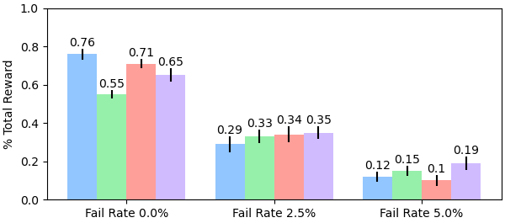
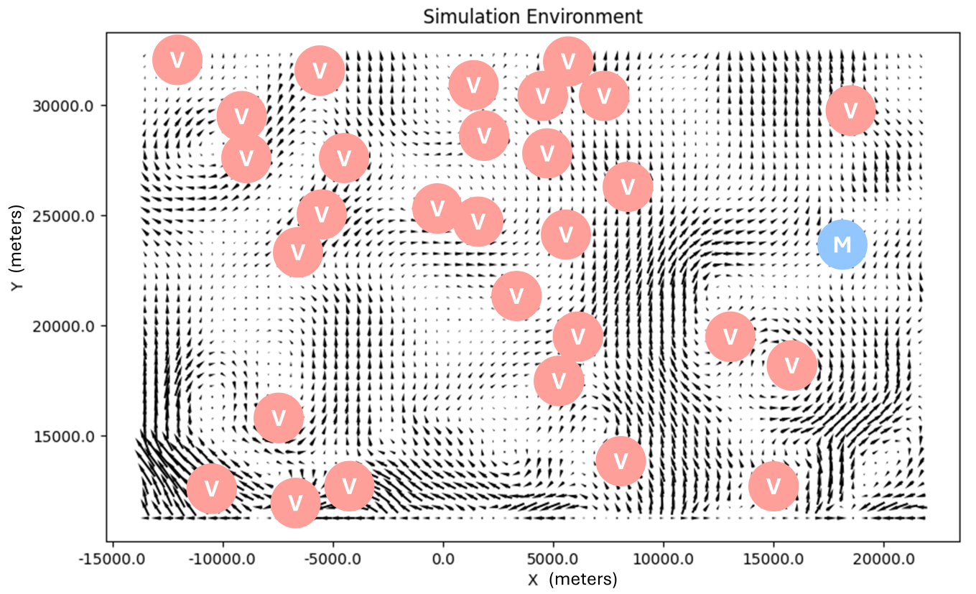
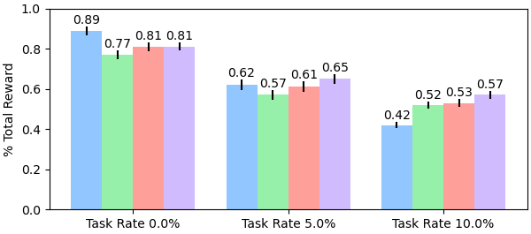


NSF Award
#2322055
Hybrid Decentralization for Multi-Robot Orienteering with Mothership-Passenger Systems
Nathan L. Butler and Geoffrey A. Hollinger
Collaborative Robotics and Intelligent Systems (CoRIS) Institute, Oregon State University
Multi-robot teams are useful for efficiently exploring isolated, hazardous environments.
If reaching the environment is itself a hazardous task, a larger mothership robot can be used to first transport the team to regions of interest.
Once the team has been deployed, passengers must solve a challenging Stochastic Multiagent Orienteering Problem to allocate tasks, plan paths, and return to the mothership for extraction within battery limits.
Opportunity: How can we leverage a hybrid centralized-decentralized network available in Mothership-Passenger systems to solve complex orienteering problems?
Hybrid Decentralized Mission Planning
We inject plans developed by a powerful centralized planner onboard the mothership into passengers’ decentralized planning routines to improve system-level coordination.
Experiments and Results
We evaluate our framework in a simulated underwater environment.
Tasks (V) and the mothership location (M) are distributed randomly.
Ocean currents from high-fidelity underwater simulator provide stochastic travel times.
We compare four algorithmic variants:
Initial, centralized solution only (Sim-BRVNS [X])
Decentralized planning only (Dec-MCTS [X])
Initial + decentralized replanning (2-Stage)
Initial + hybrid replanning (2-Stage Hybrid)
We inject disturbances (robot failures, new tasks) into the system to evaluate each method’s replanning performance.
3 Robots, 30 Tasks
6 Robots, 20 Tasks
Our hybrid planning framework offers an initial performance boost from the mothership’s centralized solver. Once deployed, the mothership improves system-level coordination in the presence of disturbances.
butlnath@oregonstate.edu
natbut.github.io
QR TO WEBSITE PAPER

